Slide 1
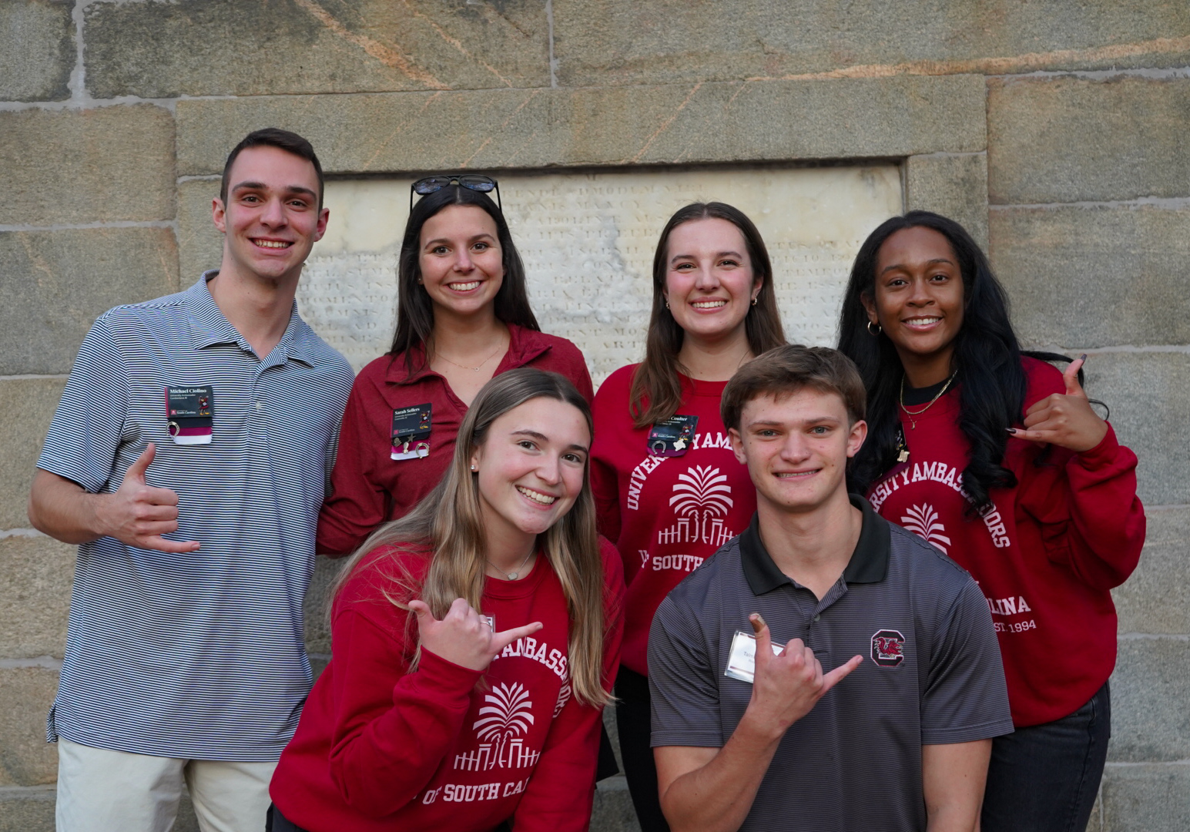
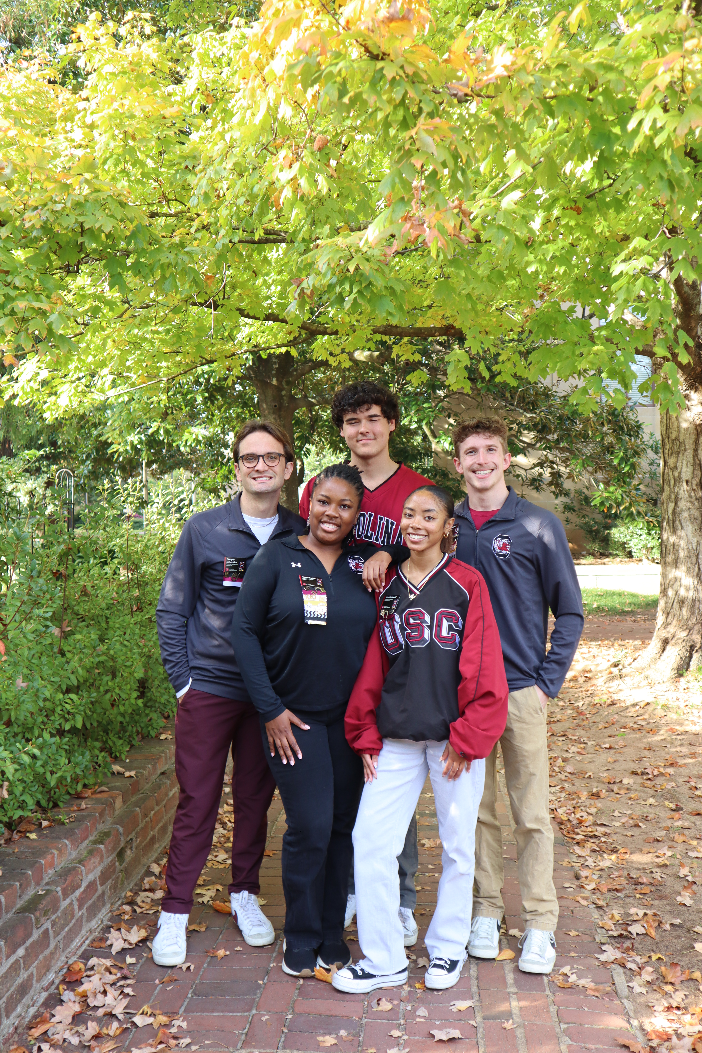
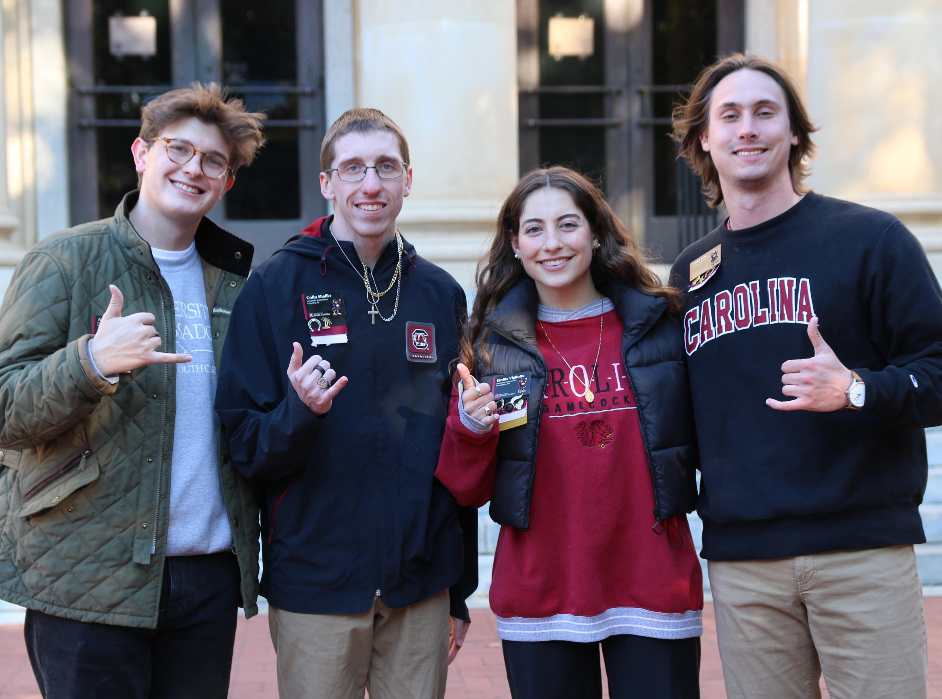
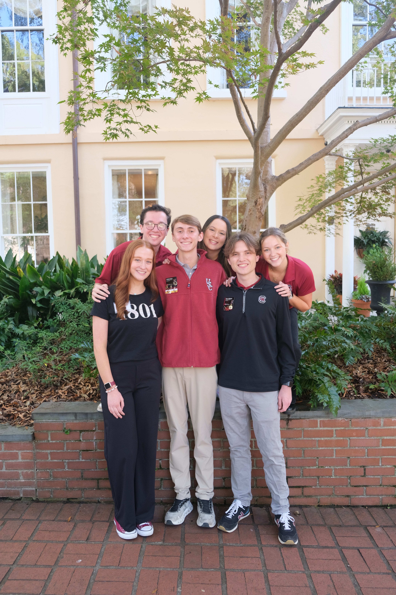


UNIVERSITY AMBASSADORS

Slide 2
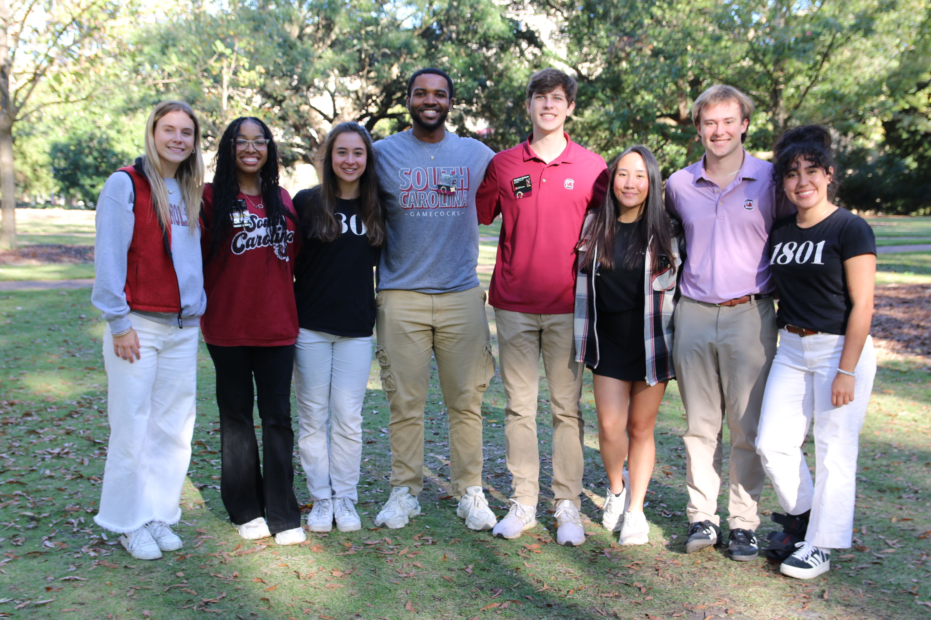
WHAT IS A UNIVERSITY AMBASSADOR?
A group of dedicated & passionate students that serve the visitors of the university and spread our passion of USC to those in their college decision process!

Slide 3
WHAT WE DO
Serve as the front door of the university by leading campus tours for high school students, their families, and special guests.
Facilitate university events like open houses and admitted students days.
Gain professional development experience, improve communication, and learn public speaking skills, applicable to any future career.
Earn paid opportunities and free USC swag.
Develop long-lasting friendships with other ambassadors.

Slide 4
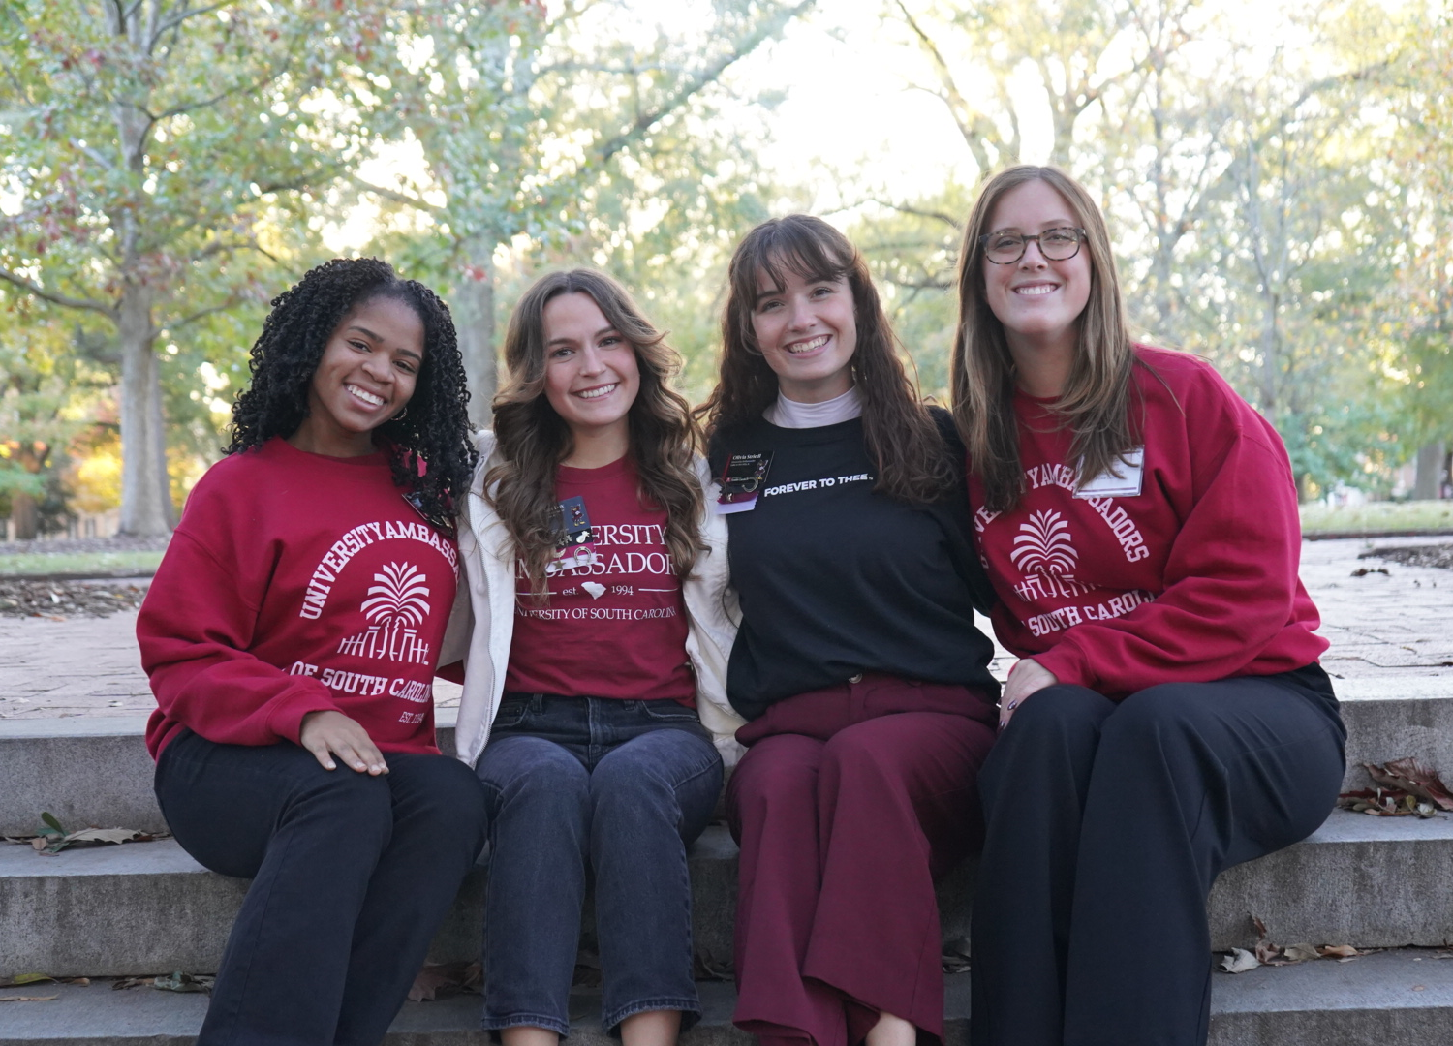
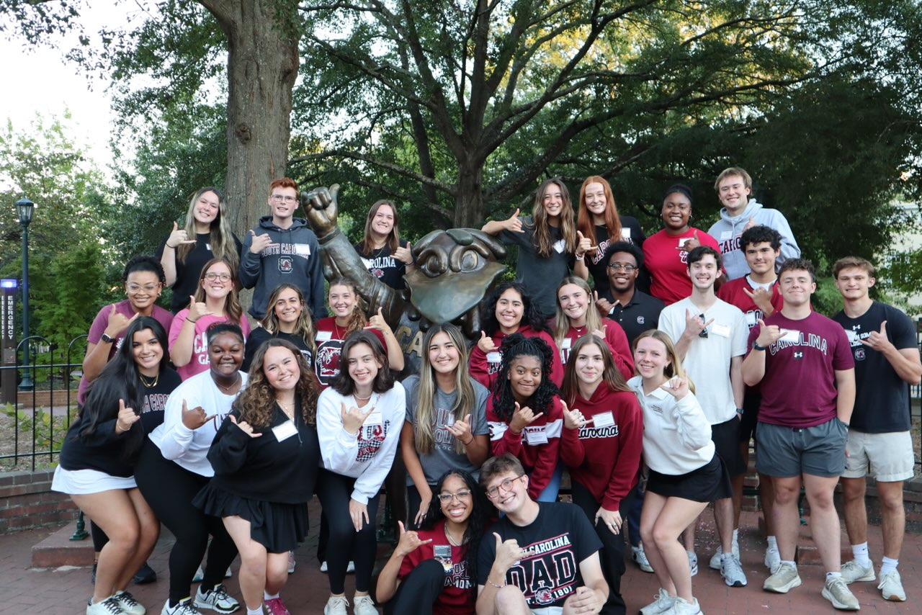
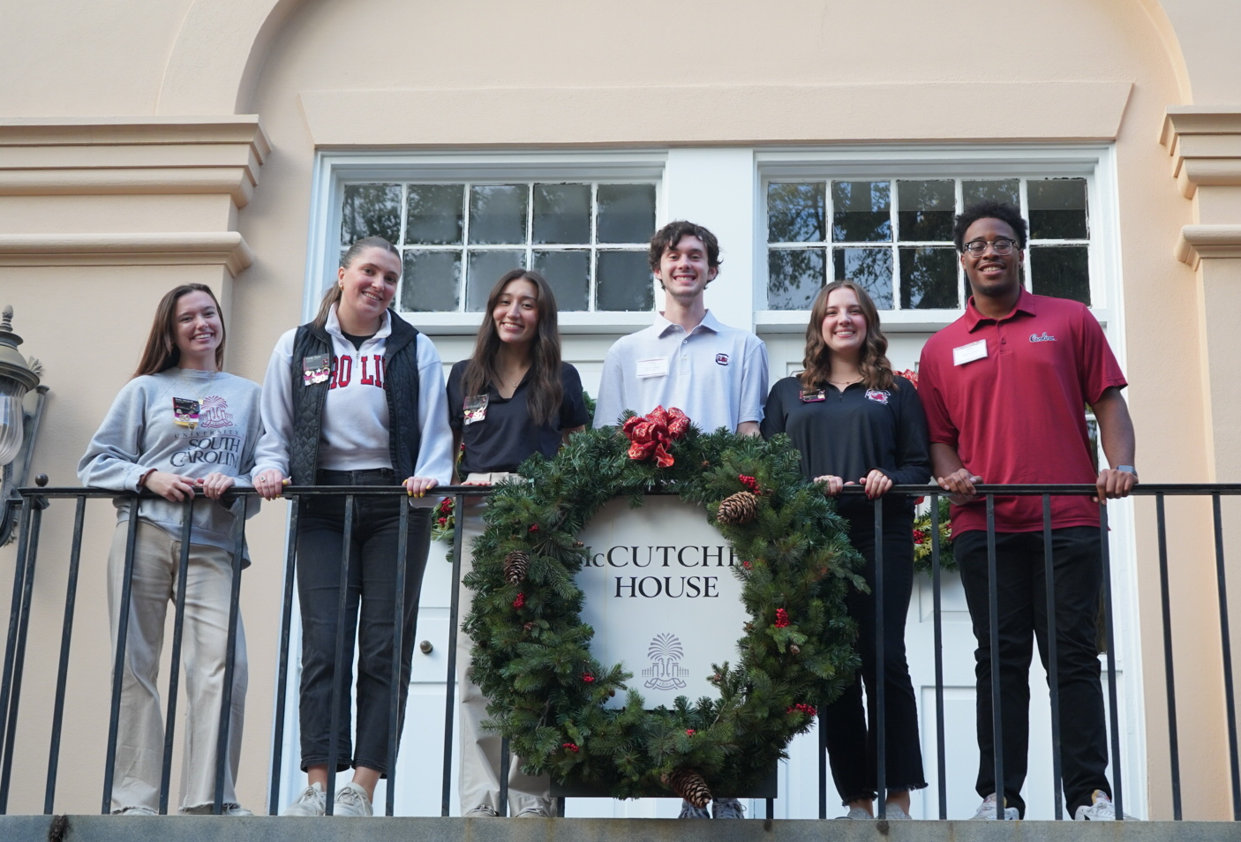
WHO WE’RE LOOKING FOR
Students who are passionate about USC
Show willingness to grow and learn
Show professionalism in and out of the Visitors Center
Are always authentically themselves!

Slide 5
WHY UA?
Notes:
Rosie

Slide 6
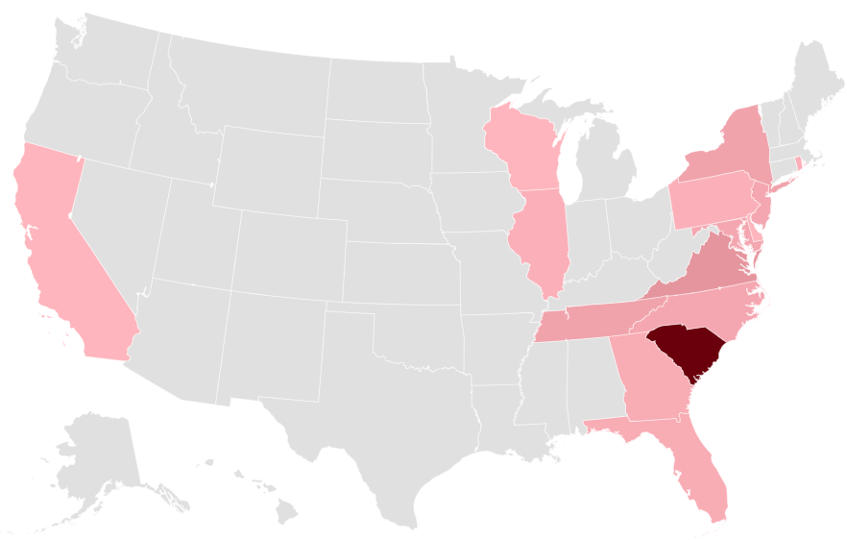
WHERE ARE WE FROM?
Ambassadors from 15 different states
41 UAs in-state vs 45 UAs out-of-state

Slide 7

35
50+
GET CONNECTED
Different degree programs University Ambassadors are enrolled in
Other student organizations where you can find our Ambassadors

Slide 8
RECRUITMENT TIMELINE
Application opened August 1st and closes on September 15th
Two rounds of interviews – beginning late September
Decisions will be made early October
Group Interviews, Tour Shadows, and Panel Interviews

Slide 9
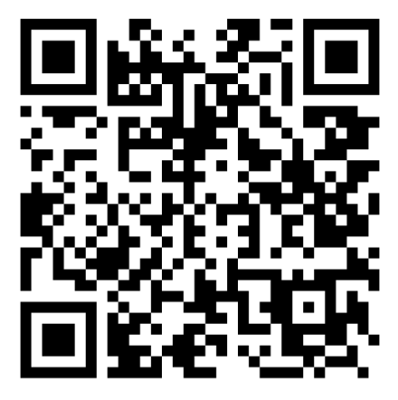

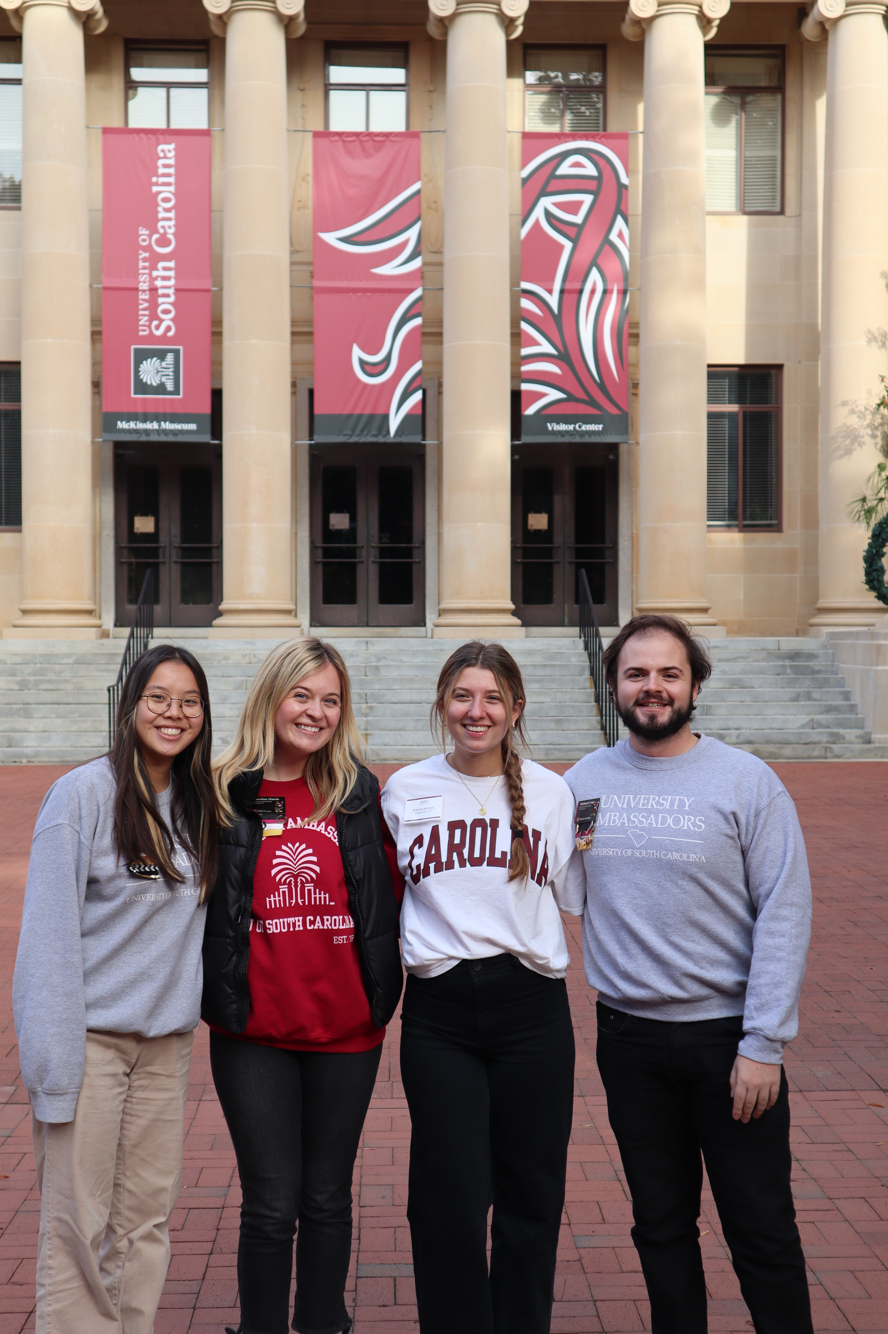


STAY IN THE KNOW
APPLY NOW
Connect with us on Instagram & TikTok
@uofscambassadors
Other Questions?
Email us at UniversityAmbassadors@sc.edu

